Slide 1
Boosting Algorithm
What is mean by Boosting Algorithm?
The boosting algorithm assesses model predictions and increases the weight of samples with a more significant error. It also assigns a weight based on model performance.
Boosting is an ensemble learning method that combines a set of weak learners into a strong learner to minimize training errors. Boosting algorithms can improve the predictive power of your data mining initiatives.
In boosting, a random sample of data is selected, fitted with a model and then trained sequentially—that is, each model tries to compensate for the weaknesses of its predecessor.

Slide 2
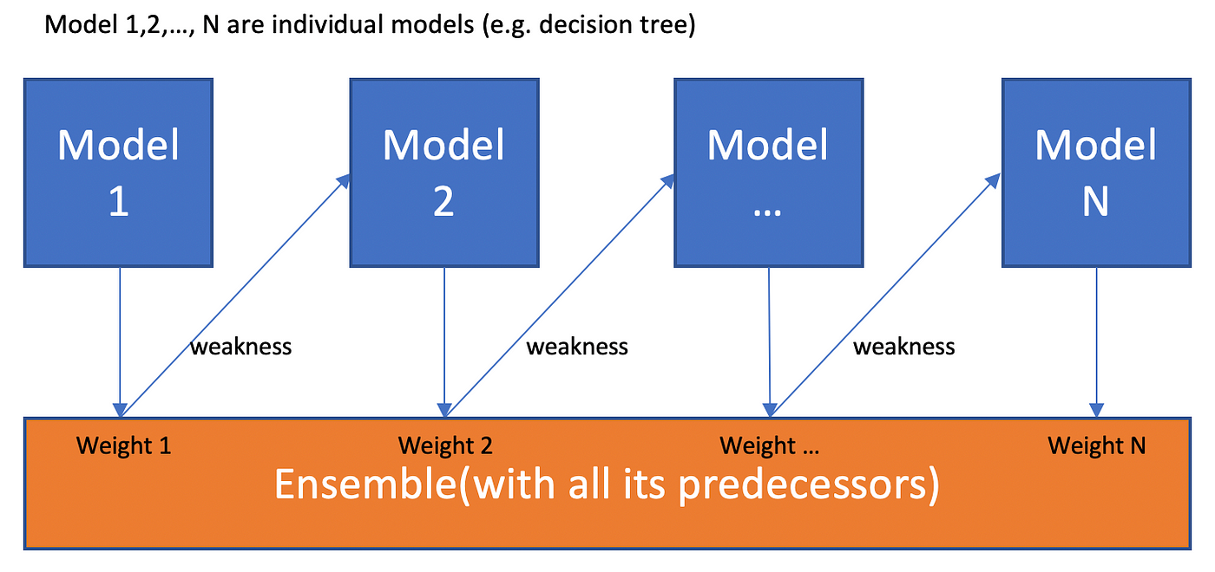

Slide 3
Types of Boosting Algorithm
Ada-boost (Adaptive Boosting)
XG-Boost (Extreme Gradient Boosting)
LG-Boost( Light Gradient-Boosting Machine)

Slide 4
Ada-boosting
Ada-Boost(adaptive boosting) is one of the ensemble boosting classifier that combines multiple weak classifiers to improve the classifiers' accuracy.
It is an iterative ensemble method.
It constructs a robust learner by combining many weak learners to get a highly accurate and robust learner.
Ada-Boost, is an ensemble machine learning algorithm that can be used in a wide variety of classification and regression tasks.
It is a supervised learning algorithm that is used to classify data by combining multiple weak or base learner.
AdaBoost can also be used in other areas of machine learning, such as regression and clustering.

Slide 5
How does Ada-Boost work?
Step 1 – Creating the First Base Learner. ...
Step 2 – Calculating the Total Error (TE) ...
Step 3 – Calculating Performance of the Stump. ...
Step 4 – Updating Weights. ...
Step 5 – Creating a New Dataset. ...

Slide 6
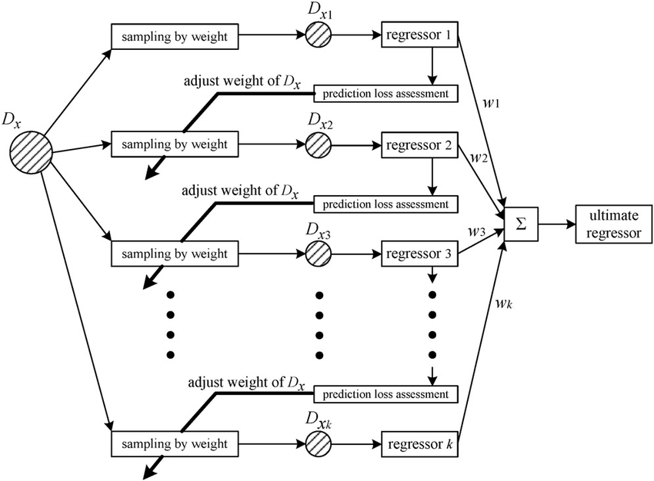
Schematic-diagram-Ada-Boost

Slide 7
Ada-Boost-Application
Computer Vision,
Natural language processing,
Bio-informatics,
Face detection,
Object recognition, and
Text classification.

Slide 8
Advantages of Ada-Boost
Can handle binary and multi-class classification problems.
Can handle noisy data and outliers.
Has a high degree of interpretability, since it relies on simple weak classifiers that can be easily understood.
Often results in high accuracy and outperforms other algorithms in many scenarios.

Slide 9
Disadvantage of Ada-Boost
Can be computationally expensive, especially with large datasets.
Can lead to overfitting if the weak classifiers are too complex or if the number of boosting iterations is too high.
Requires careful parameter tuning to achieve optimal performance.
Sensitive to Noisy Data and Outliers

Slide 10
XG-Boost
XGBoost, which stands for (Extreme Gradient Boosting)is a scalable, distributed gradient-boosted decision tree (GBDT) machine learning library.
It provides parallel tree boosting and is the leading machine learning library for regression, classification, and ranking problems.
XGBoost is a scalable and highly accurate implementation of gradient boosting that pushes the limits of computing power for boosted tree algorithms, being built largely for energizing machine learning model performance and computational speed.

Slide 11
How XGBoost Works?
Step 1: Initialize with a Simple Model. ...
Step 2: Calculate Residuals. ...
Step 3: Build a Tree to Predict Residuals. ...
Step 4: Update Predictions. ...
Step 5: Calculate New Residuals. ...
Step 6: Build Another Tree. ...
Step 7: Combine Predictions.

Slide 12
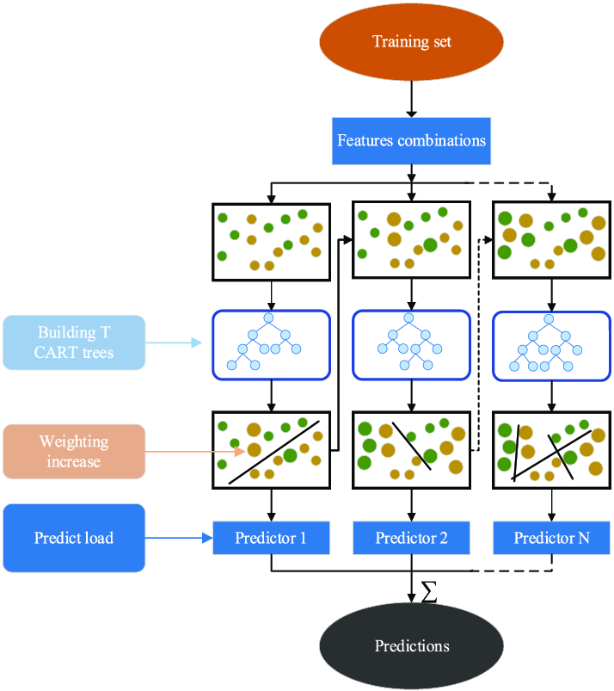
Schematic-diagram-XG-Boost

Slide 13
Application of XG-Boost
Hydrological modelling,
Forecasting water quantity and quality,
Groundwater management,
XGBoost for classification, regression, ranking, and even user-defined prediction challenges.

Slide 14
Advantage of XG-Boost
XGBoost is designed for speed, easy to use, and performance on large datasets.
It does not require optimization of the parameters or tuning, which means that it can be used immediately after installation without any further configuration.
Ability to handle missing data and large datasets efficiently.
XGBoost is a powerful and flexible algorithm that can be an effective tool for machine learning tasks that require high accuracy and speed.

Slide 15
Disadvantage of XG-Boost
XGBoost does not perform so well on sparse and unstructured data
complexity, potential for overfitting, memory usage, and lack of transparency. As with any machine learning algorithm.

Slide 16
LG-Boost
LightGBM (Light Gradient-Boosting Machine), is a free and open-source distributed gradient-boosting framework for machine learning, originally developed by Microsoft.
A LightGBM regression model is made up of n_estimators (default value is 100) relatively small decision trees that are called weak learners, or sometimes base learners.
LightGBM can perform multi-class classification, binary classification (predict one of two possible values), regression (predict a single numeric value) and ranking.
The lightGBM technique is comprised of two main approaches: exclusive feature budling (EFB) and gradient-based one-side sampling (GOSS)
The principle of LightGBM revolves around efficiency, scalability, and accuracy.

Slide 17
How does LG-Boost work?
Steps in LightGBM Algorithm
Data Preprocessing: The first step is to prepare the data for model training. ...
Splitting the data: The data is then split into training and validation sets. ...
Initialization: LightGBM starts with a single decision tree grown from the root node.
LightGBM uses a histogram-based method in which data is bucketed into bins using a histogram of the distribution. The bins, instead of each data point, are used to iterate, calculate the gain, and split the data.

Slide 18
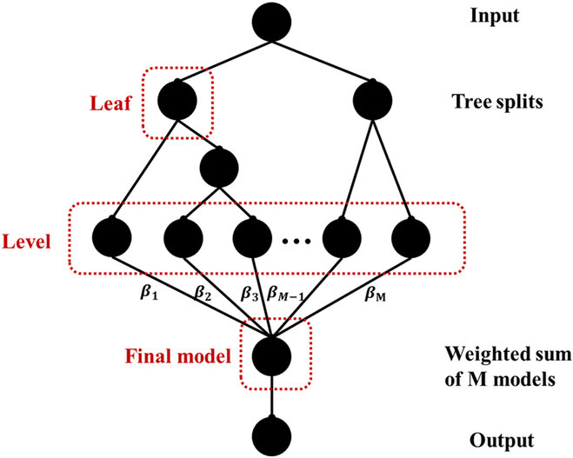
Schematic-Diagram-LG-Boost

Slide 19
LG-Boost Application
LightGBM is used for supervised learning tasks, particularly for classification and regression problems
Light GBM can handle the large size of data and takes lower memory to run
It optimizes memory usage and training time with techniques like Gradient-based One-Side Sampling (GOSS).

Slide 20
Advantage of LG-Boost
Faster training speed and higher efficiency: Light GBM uses a histogram-based algorithm i.e it buckets continuous feature values into discrete bins which fasten the training procedure.
Lower memory usage: Replaces continuous values to discrete bins which results in lower memory usage.
Better accuracy than any other boosting algorithm

Slide 21
Disadvantage of LG-Boost
Interpretability challenges
It may under-perform on small datasets because of the complexity reduction methods used.
It may over-fit on noisy data because of the large number of trees used.
It may not be suitable for very deep trees, as the leaf-wise tree growth method used by LightGBM can cause over-fitting.

